Slide 1
SHARED DOCKLESS MOBILITY: PREDICTING USAGE
Gillian Foster, Saranya Nagarajan, Katherine Wroble, Malik Ouda, Mounika Tarigopula, Nadia Florez

Slide 2
TABLE OF CONTENTS
01
02
03
04
VISUALIZATIONS
MODELING
REFLECTIONS
BACKGROUND + DATA DESCRIPTION

Slide 3
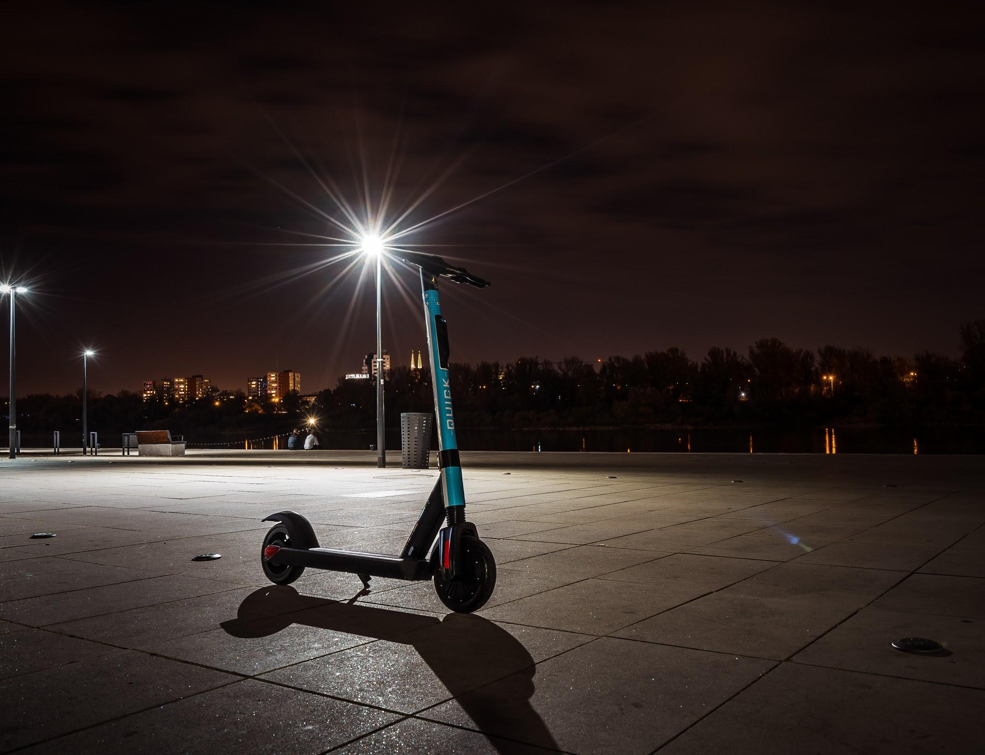

BACKGROUND
A new form of transportation: shared dockless mobility
We use advanced analytics to predict number of trips from shared dockless mobility services by leveraging historical weather and shared dockless mobility data
Our model will help service provides better meet demand, limit the number of idle scooters and maximize customer satisfaction
Notes:
Advancements in location-based services, the Internet, and mobile technologies have contributed to a new form of transportation: shared dockless mobility (these are the short-term rental scooters you see downtown cruising down the wrong side of the street or crashing into pedestrians on the sidewalks)
We use advanced analytics to predict number of trips from shared dockless mobility services by leveraging historical weather and historical shared dockless mobility data with the aim to help service provides better meet demand, limit the number of idle scooters and maximize customer satisfaction

Slide 4
DATA DESCRIPTION
Data preprocessing
Original mobility dataset: ~10MM rows of individual trip information
Cleaned and merged with weather data
Data description
April 4, 2018 - November 16, 2020
1450 rows, 23 columns
Merged weather + mobility data
Mobility data: Number of scooter/bicycle/moped trips, average trip duration and distance, date information
Weather data: Temperature, humidity, dew point, wind speed, pressure, precipitation
Notes:
Malik
Our final dataset that we used for modeling contained data from two datasets: a mobility dataset, and a weather dataset. The mobility dataset that we began with contained about 10 million rows of data about trips on personal mobility vehicles: bicycles, scooters, and mopeds. We took this data and cleaned it, aggregated it by day, and merged it with daily weather data to further improve our predictions in our modeling pipeline. Our cleaned and merged dataset contained information from April 4th, 2018 to November 16th, 2020. It contained 1450 rows, and 23 columns where each row represented one day of mobility and weather information. The mobility data contained aggregated data about the number of trips per day per vehicle type, the average trip duration and distance, as well as date information. Our weather data, which required no cleaning, contained data about the temperature, wind speed, and precipitation, and others, however we only used the most relevant of these columns in our final models, as not all of the columns would have a large effect on mobility vehicle usage.

Slide 5
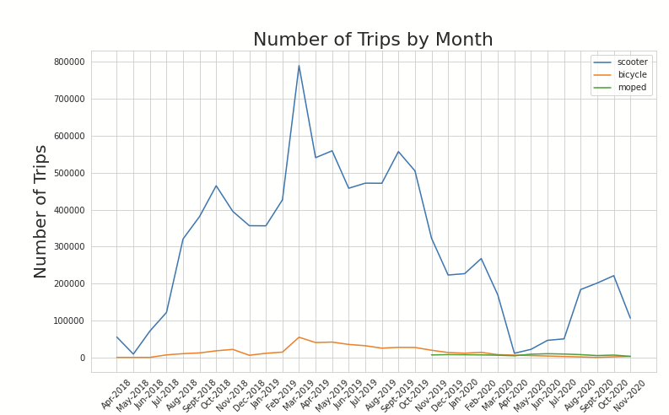
VISUALIZATION: MOBILITY DATA
Mopeds were introduced in late 2019
Scooter rides are by far the most popular mode
Seasonality effects are present
Covid-19 sharply reduced number of trips from starting in March 2020
Notes:
The three types of mobility (scooter, bicycle, moped) have different times at which they have been available to consumers. Most notably mopeds have been around since late 2019 while scooter and bicycles have been around early to mid 2018.
Scooter rides are by far the most popular choice
we see an increase in scooter rides from april 2018 through sept 2018 probably because a) more people became accustomed to the new mode of shared mobility and b) more of the vehicles were available from more and more vendors.
we see seasonality effects where oct-dec 2018 and 2019 had a dip in numbers
we see the effect of covid-19 as sharp decrease from march to april 2020

Slide 6
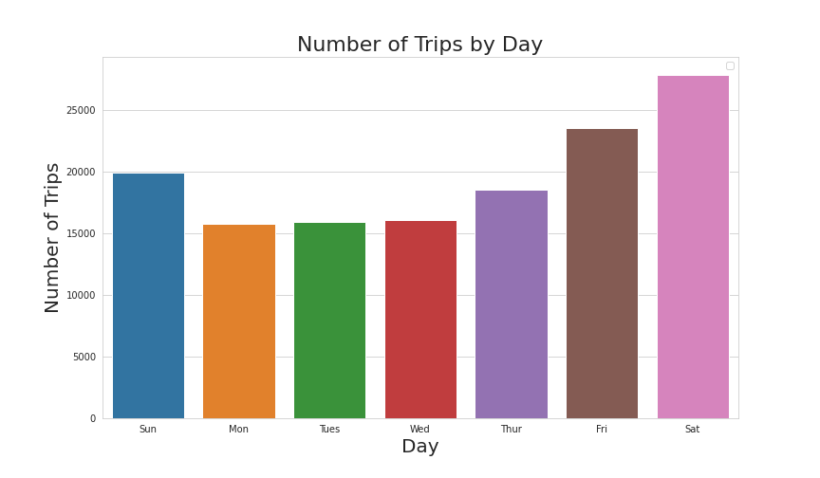
VISUALIZATION: MOBILITY DATA
The plot shows that shared mobility trips occur mostly on Friday, Saturday and Sunday. Particularly, Saturday shows the highest amount of trips

Slide 7
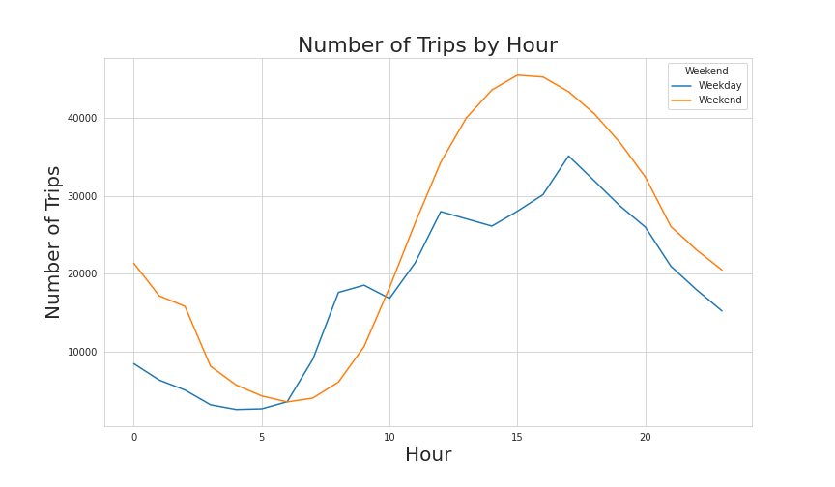
VISUALIZATION: MOBILITY DATA
On average, weekends have a greater number of trips than weekdays
Weekends see a steady rise in number of trips throughout morning and early afternoon hours, peak around 3pm and decrease after.
For weekdays, we see three peaks
Notes:
From the plot above, we see that, on average, weekends have a greater number of trips than weekdays. Weekends see a steady rise in number of trips throughout morning and early afternoon hours, peak around 3pm and decrease after.
For weekdays, we see three peaks: one in the morning, one midday and one in the early evening. These peaks probably correspond to morning and afternoon rush hours, as well as lunch time.

Slide 8
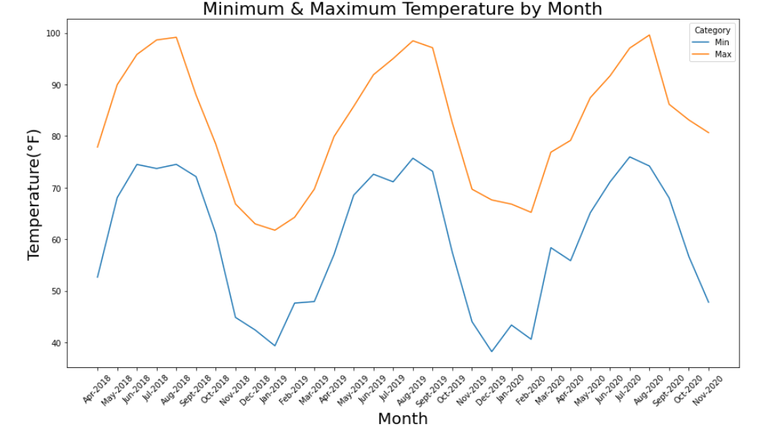
VISUALIZATION: WEATHER
Gathered daily weather data for the same period as the mobility data
Highest temperature observed during June/July
Lowest temperature during December/ January

Slide 9
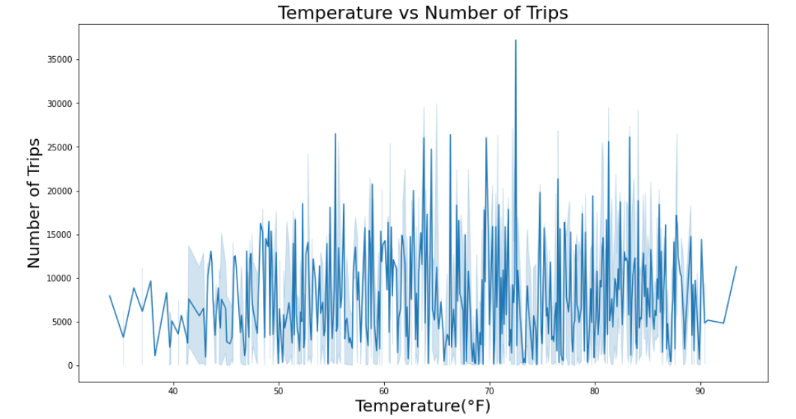
VISUALIZATION: WEATHER VS. TRIPS
Number of trips at a lower range for 40F<temp>90F
No distinct correlation between temperature and number of trips for a normal temperature range
Notes:
From Nadia + Gillian: we should mention that we expected a trend b/w temp and num of trips, but there is no clear indication of one

Slide 10
MODELING - What Didn’t Work
CatBoost
Random Forests
XGBoost
Decision Tree
Good for categorical values
Performs well for multi-class object detection
Performs well with unbalanced data
Good when simplicity is important
Notes:
We will start with talking about what didn’t work. Intuitively, we thought these more complex models would provide better results, but it turned out we were wrong.
So on this slide, you can see that we have listed out what each of the models we have tried are good for when making a predictive model
Starting with CatBoost, we know that it works best with categorical values, and our data was mainly quantitative
Next, random forests are good for multi-class object detection, which ended up performing the best out of these models, but not the best overall
Next XGBoost is known for performing well with unbalanced data
And decision trees are good when simplicity is important and computing power is limited
These descriptions were important because they helped us realize why the models didnt work for our data.

Slide 11
MODELING - What Didn’t Work
XGBoost
Random Forests
Decision Tree
CatBoost
MSE: 101,681,458
MSE: 37,000,954
MSE: 42,182,216
MSE: 67,575,173
Notes:
So on this slide you can see the Mean Squared Error Values for each of our models.
Mean Squared Error is the metric we used to gauge the accuracy of each model. We used MSE because it is a simple metric that checks how close estimates or forecasts are to actual values.
We first tried each model “out-of-the-box” with little to no hyperparameter tuning to find out which model fits our data best.
You can see that decision trees did not perform well at all, followed by random forests. XGBoost and CatBoost had similar performance, but still did not have the best overall MSE.
It turned out that the model Gillian will talk about next fit our data best, so we did not end up doing more hyperparameter tuning with these models.

Slide 12
MODELING- What Worked
Linear Regression
One-Hot Encoding
Time Series
Tuned with L1 regularization and limited weather data
Creating numerical features from weekdays and months
Inclusion of the previous day’s trip count was our most significant improvement

Slide 13
24,237,005
3,771
Final Regression MSE
Final Regression MAE
Notes:
Perhaps hourly values might work better
Trim date range to “useful” data points

Slide 14
REFLECTIONS
Interesting data insights and visualizations
Achieved minimally accurate model for predicting vehicle usage
Usefulness of the model
Can be used to predict usage and increase or decrease supply accordingly
Minimize cost of idle scooters
Using some weather data improved our model
Holiday and event (ACL and SXSW) data could improve our model
Notes:
Malik
As we come to a close on this project, we feel as a team we have built a really successful project that ultimately resulted in very interesting visualizations of our data that provided a lot of insights into mobility usage in Austin, and we also ended up with a fair model for predicting vehicle usage. This model could potentially be used by the City of Austin or mobility companies to predict usage and increase or decrease supply accordingly, ultimately minimizing the cost of idle scooters. We were able to achieve this model by combining our data with a weather dataset, and we could likely further improve our model by including data about holidays, event, and other human behaviors to get a better sense of when people are more likely to use scooters in Austin.

Slide 15
THANK YOU!
Notes:
Overall, we had a really good time building out this project from the data preprocessing pipeline to the visualizations to our final model. We found the mobility dataset fun to explore and enjoyed being able to apply the skills and strategies we learned into this course to a dataset that has real implications and a more concrete context. Thank you for listening!

